Slide 1
Task Findings
Model evaluation

Slide 2
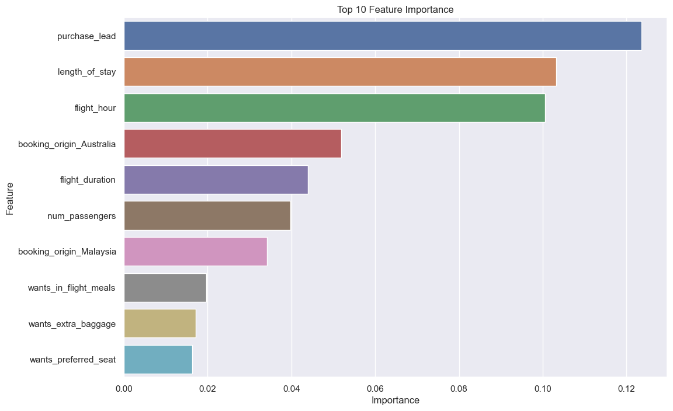
Variable Importance
Insights:
Purchase lead is the most influential feature, indicating its strong impact on predicting customer bookings.
Length of stay and Flight Hours also contribute significantly to the model’s predictive power.
Features related to booking origin (Australia and Malaysia) show notable importance.
Wants In-Flight Meals, Wants Extra baggage, and Wants Preferred Seat have a moderate impact.
Model evaluation:
Before balancing class weights, the model exhibited imbalanced performance, with a lower recall of 0.11 for positive instances (class 1). After balancing weights, the model showed a substantial improvement, achieving perfect recall (1.00) for both classes, indicating enhanced generalization and mitigated biases from class imbalances.

